Slide 1

In Jesus Name (God of Possible)

Slide 2
Bm G
I speak the name of Jesus over you
D A
In your hurting, in your sorrow, I will ask my God to move
Bm G
I speak the name 'cause it's all that I can do
D A
In desperation I'll seek heaven and pray this for you
CAPO @ 3rd (F)

Slide 3
Bm G
I pray for your healing, that circumstances would change
D A
I pray that the fear inside would flee in Jesus name
Bm D
I pray that a breakthrough would happen today
D A
I pray miracles over your life in Jesus name
Bm D G
In Jesus name
To verse 2

Slide 4
Bm G
I speak the name of all authority
D A
Declaring blessings, ev'ry promise He is faithful to keep
Bm G
I speak the name no grave could ever hold
D A
He is greater, He is stronger, He's the God of possible
To Chorus

Slide 5
Bm G
I pray for your healing, that circumstances would change
D A
I pray that the fear inside would flee in Jesus name
Bm D
I pray that a breakthrough would happen today
D A
I pray miracles over your life in Jesus name
Bm G
In Jesus name
To Bridge

Slide 6
Em G
Come believe it, come receive it
D Asus A
Oh, the power of His Spirit is now forever yours
Em G
Come believe it, come receive it
D Asus A
In the mighty name of Jesus, all things are possible
To Chorus

Slide 7
Bm G
I pray for your healing, that circumstances would change
D A
I pray that the fear inside would flee in Jesus name
Bm D
I pray that a breakthrough would happen today
D A
I pray miracles over your life in Jesus name

Slide 8
Bm G
I pray for revival, for restoration of faith
D
I pray that the dead will come alive
Asus A Bm
In Jesus name, in Jesus name
Bm / G / D / A
END

Slide 9
How Great Thou Art

Slide 10
G C
O Lord my God, When I in awesome wonder
G D G
Consider all the Worlds Thy hand hath made
G C
I see the stars, I hear the rolling thunder
G D G
Thy pow'r throughout the universe displayed

Slide 11
G C G
Then sings my soul, my Savior God, to Thee
Am G
How great Thou art! How great Thou art!
G C G
Then sings my soul, my Savior God, to Thee
Am C G
How great Thou art! How great Thou art!

Slide 12
G C
And when I think that God, His Son not sparing
G D G
Sent Him to die, I scarce can take it in
G
That on the cross, my burden gladly bearing
G D G
He bled and died to take away my sin

Slide 13
G C G
Then sings my soul, my Savior God, to Thee
Am G
How great Thou art! How great Thou art!
G C G
Then sings my soul, my Savior God, to Thee
Am C G
How great Thou art! How great Thou art!

Slide 14
G C
When Christ shall come, with shouts of acclamation
G D G
And take me home, what joy shall fill my heart
G C
Then I shall bow in humble adoration
G D G
And there proclaim, My God, how great You are!
END

Slide 15
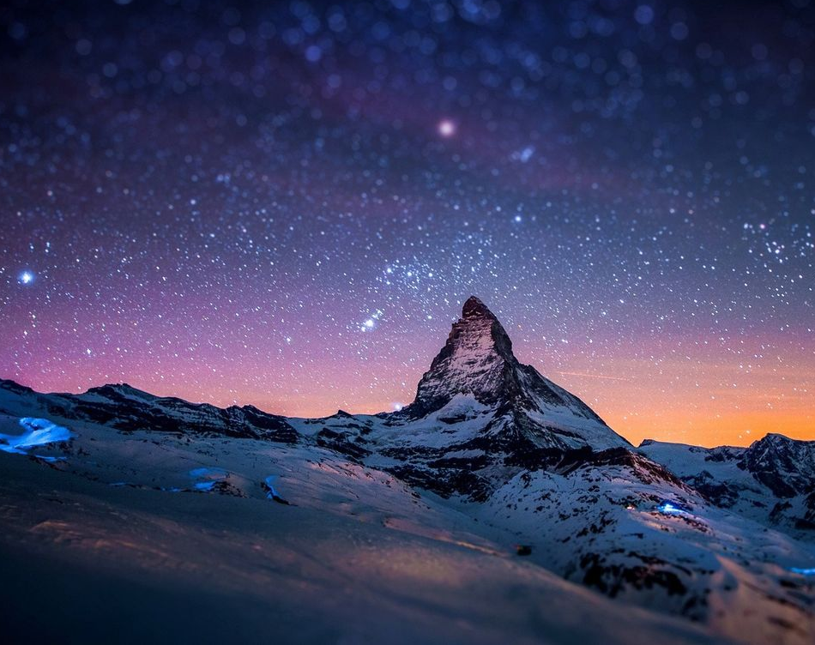
Goodness of God

Slide 16
G C G
I love You Lord Oh, For Your mercy never fails me
Em C D
All my days, I've been held in Your hands
Em C
From the moment that I wake up
G D Em
Until I lay my head
C D Gsus4 G
I will sing of the goodness of God
CAPO @ 1

Slide 17
C G
All my life You have been faithful
C G D
All my life You have been so, so good
C G D Em
With every breath that I am able
C D Gsus4 G
I will sing of the goodness of God

Slide 18
G C G
I love Your voice You have led me through the fire
G Em C D
In my darkest night, You were close like no other
Em C
I've known You as a father
F D Em
I've known You as a friend
C D G
I have lived in the goodness of God

Slide 19
C G
All my life You have been faithful
C G D
All my life You have been so, so good
C G D Em
With every breath that I am able
C D Gsus4 G
I will sing of the goodness of God

Slide 20
G C D G
Your goodness is running after, it’s running after me
G C D G
Your goodness is running after, it’s running after me
G C
With my life laid down, I’m surrendered now,
D Em
I give You everything
G C D G
Your goodness is running after, it’s running after me
x2

Slide 21
C G
All my life You have been faithful
C G D
All my life You have been so, so good
C G D Em
With every breath that I am able
C D Gsus4 G
I will sing of the goodness of God

Slide 22
C G
All my life You have been faithful
C G D
All my life You have been so, so good
C G D Em
With every breath that I am able
C D Gsus4 G
I will sing of the goodness of God
END

Slide 23
Above All

Slide 24
CAPO 3rd
G A D
Above all powers, above all Kings
G A D
Above all nature, and all created things
Bm A G D
Above all wisdom, and all the ways of man
Em A D
You were here before the world began

Slide 25
G A D
Above all kingdoms, above all thrones
G A D
Above all wonders this world has ever known
Bm A G D
Above all wealth and treasures of the earth
Em G F#
There's no way to measure what You're worth

Slide 26
D Em A D
Crucified, laid behind a stone
D Em A D
You lived to die, rejected and alone
Bm A G D
Like a rose, trampled on the ground
Em D G A D
You took the fall, and thought of me Above all

Slide 27
G A D
Above all powers, above all Kings
G A D
Above all nature, and all created things
Bm A G D
Above all wisdom, and all the ways of man
Em A D
You were here before the world began

Slide 28
G A D
Above all kingdoms, above all thrones
G A D
Above all wonders this world has ever known
Bm A G D
Above all wealth and treasures of the earth
Em G F#
There's no way to measure what You're worth

Slide 29
D Em A D
Crucified, laid behind a stone
D Em A D
You lived to die, rejected and alone
Bm A G D
Like a rose, trampled on the ground
Em D G A D
You took the fall, and thought of me Above all
Play x2

Slide 30
Bm A G D
Like a rose, trampled on the ground
Em D G A D
You took the fall, and thought of me Above all
END

